Slide 1
Learning Objectives
WALT: Understand the relationship between an animals characteristics and their habitat
WILF:
To explain that the Earth provides a range of different habitats. (level 3)
To describe animals special features or behaviours (adaptations) that aid their survival. (level 4)
To analyse how plants/animals are adapted to the temperature, food and water supply in their habitat. (level 5)
To link the changes in environmental conditions to the survival of individuals and whole species. (level 6)
Key Terms: Adaptation, environment, habitat

Slide 2
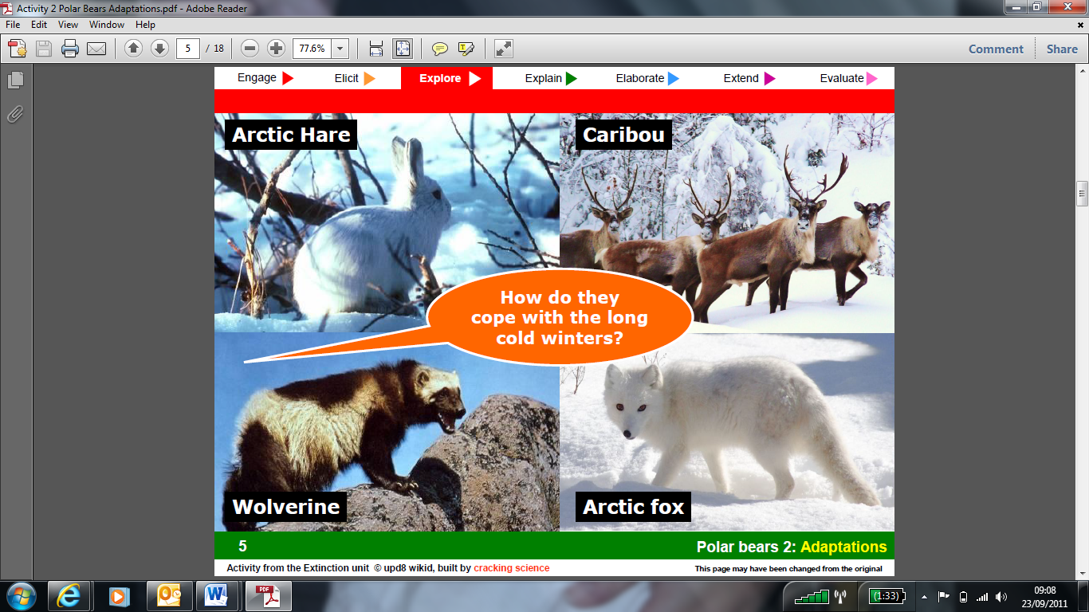

Slide 3
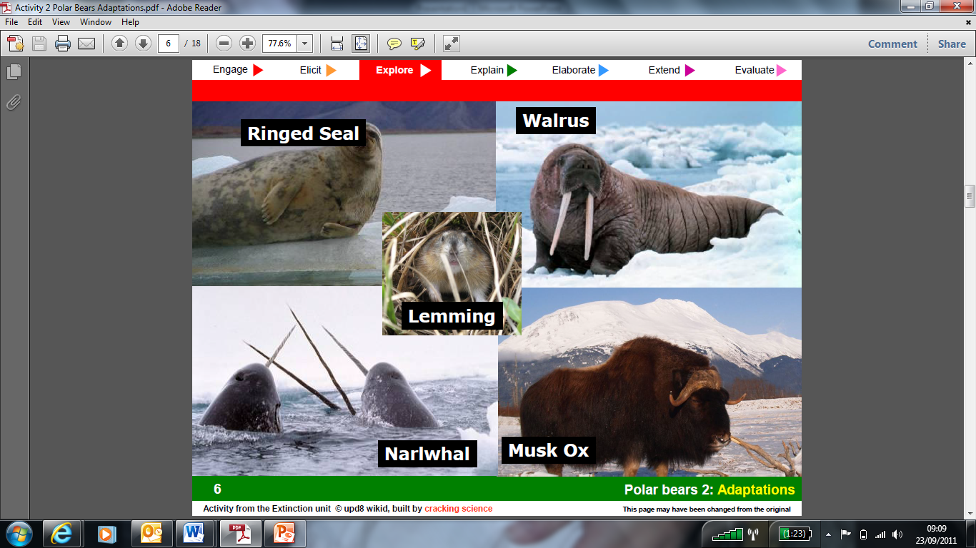

Slide 4
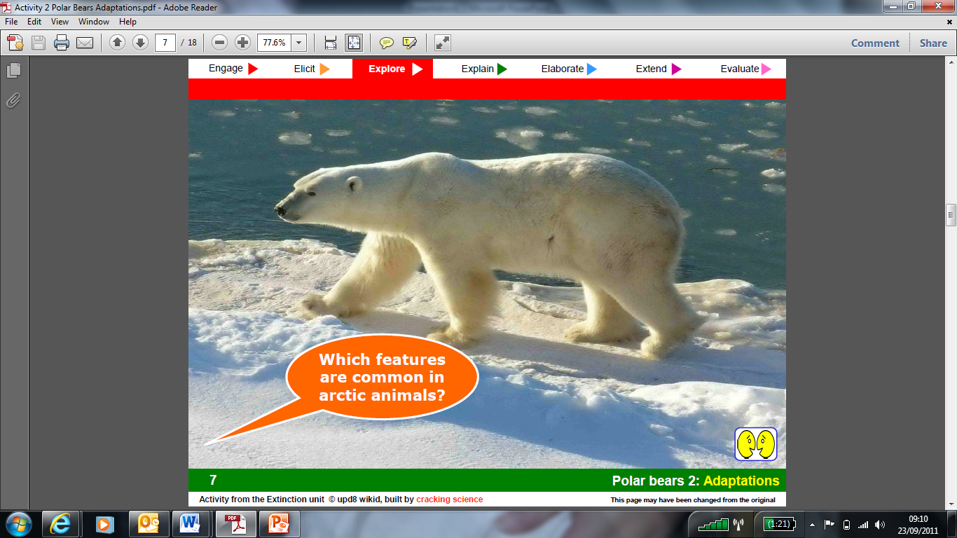

Slide 5
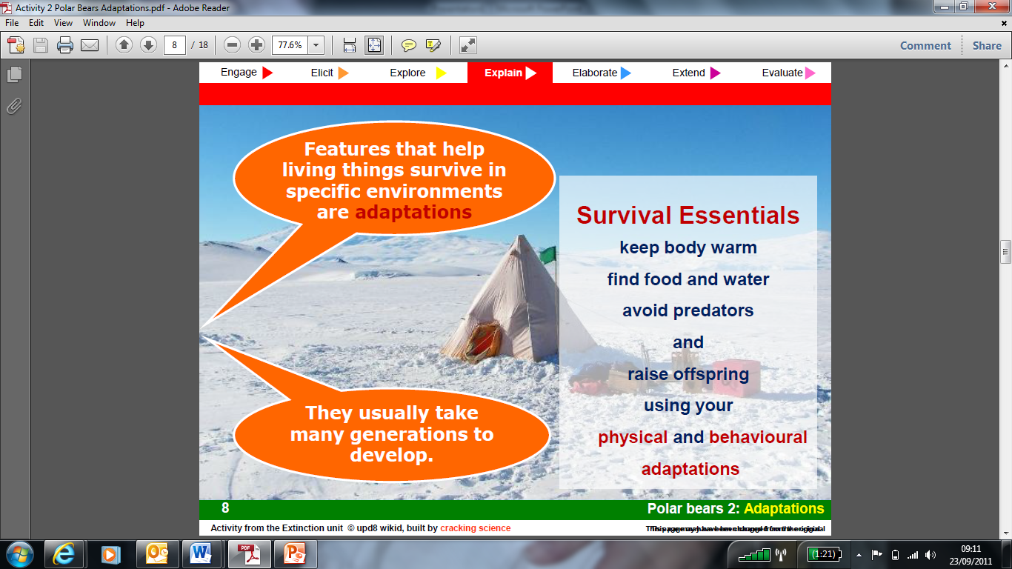

Slide 6
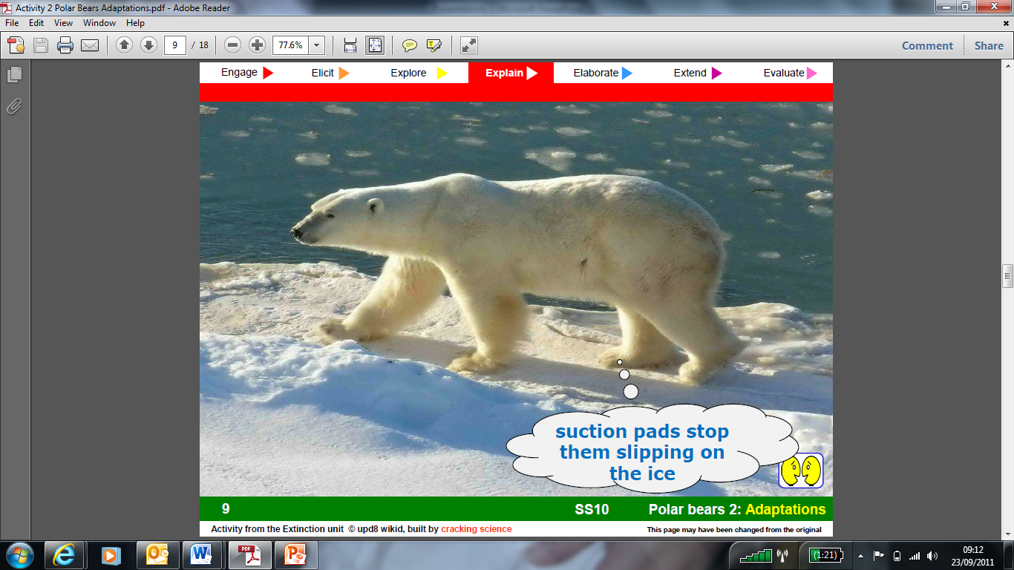

Slide 7
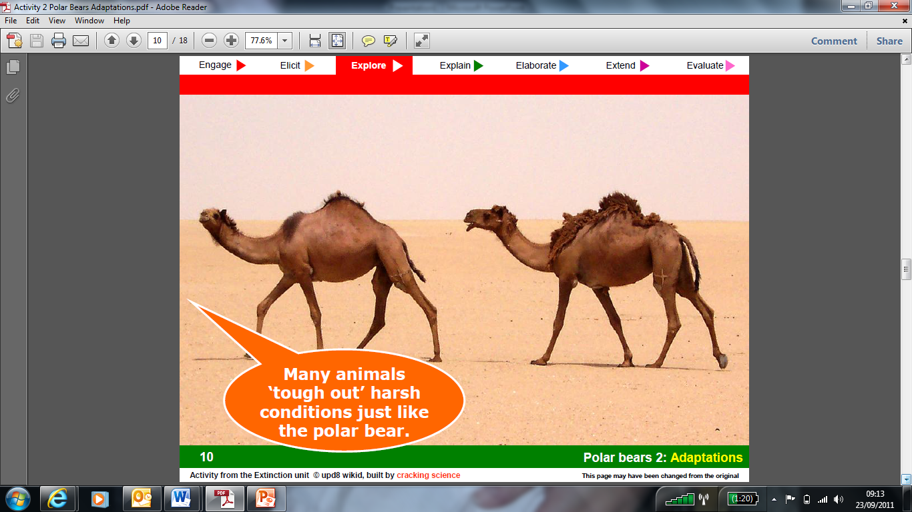

Slide 8
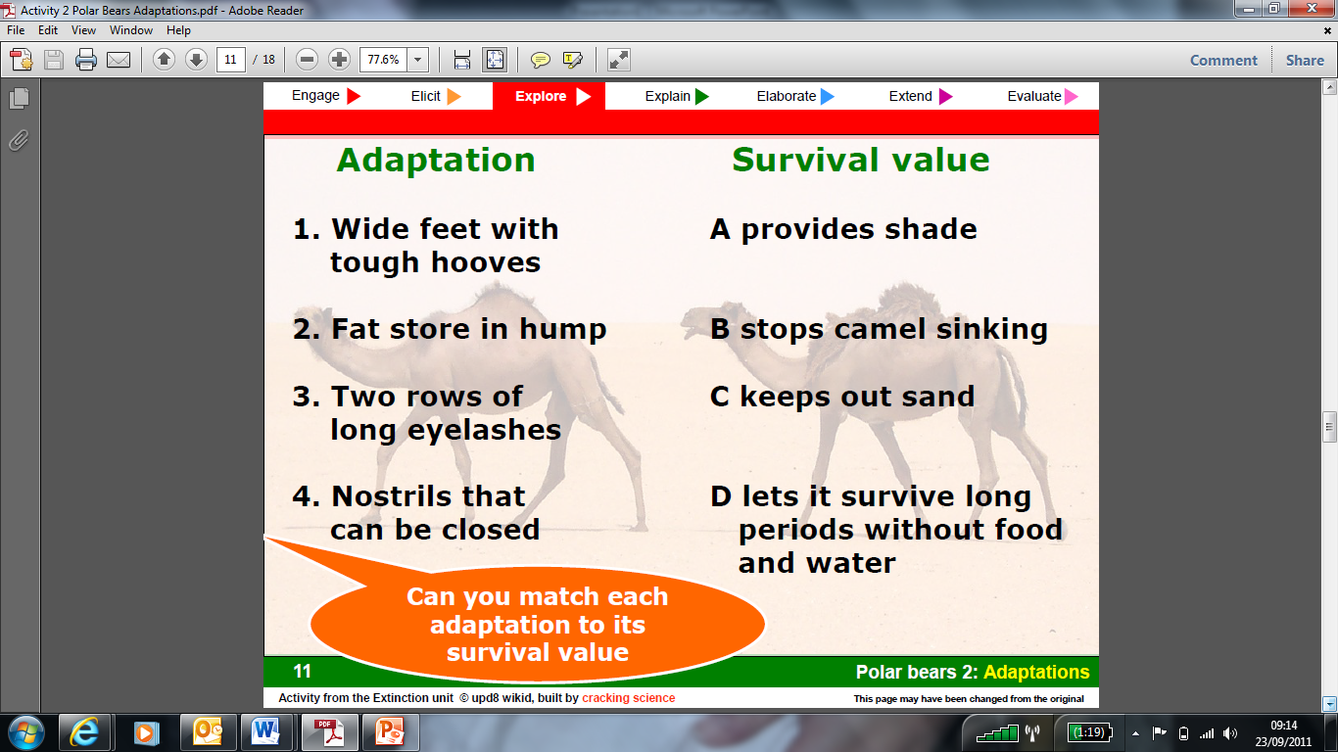

Slide 9
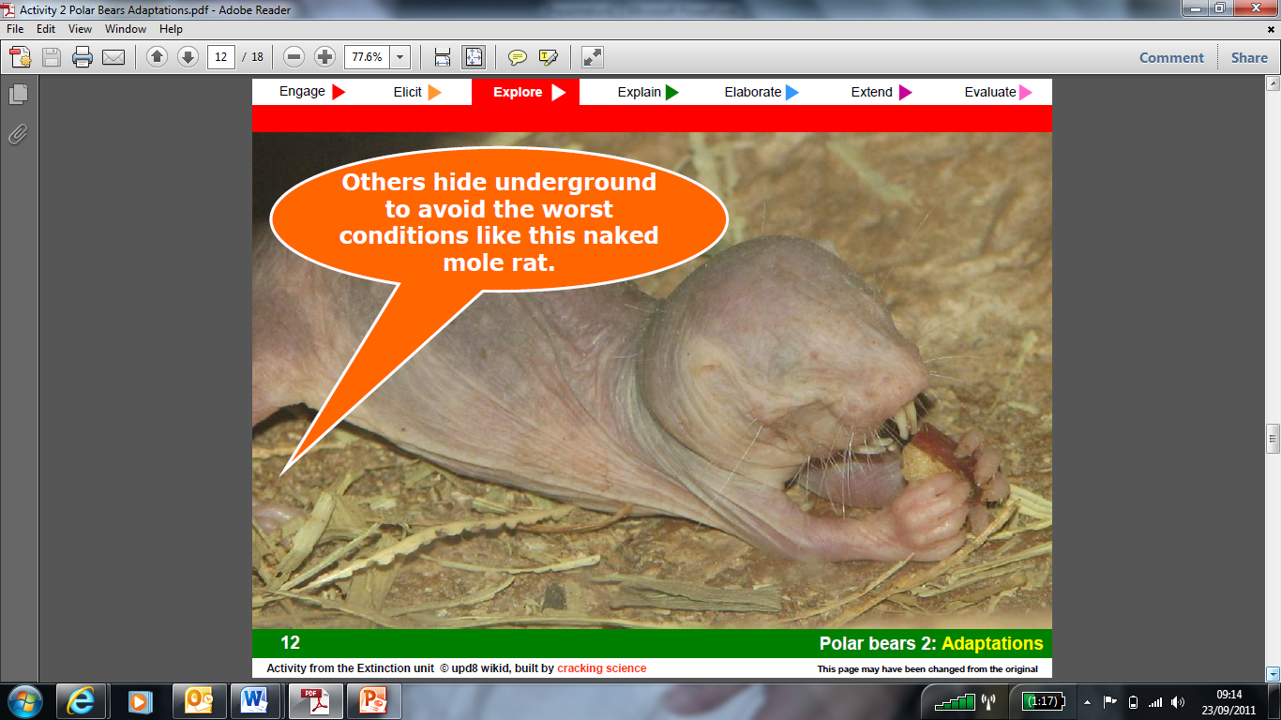

Slide 10
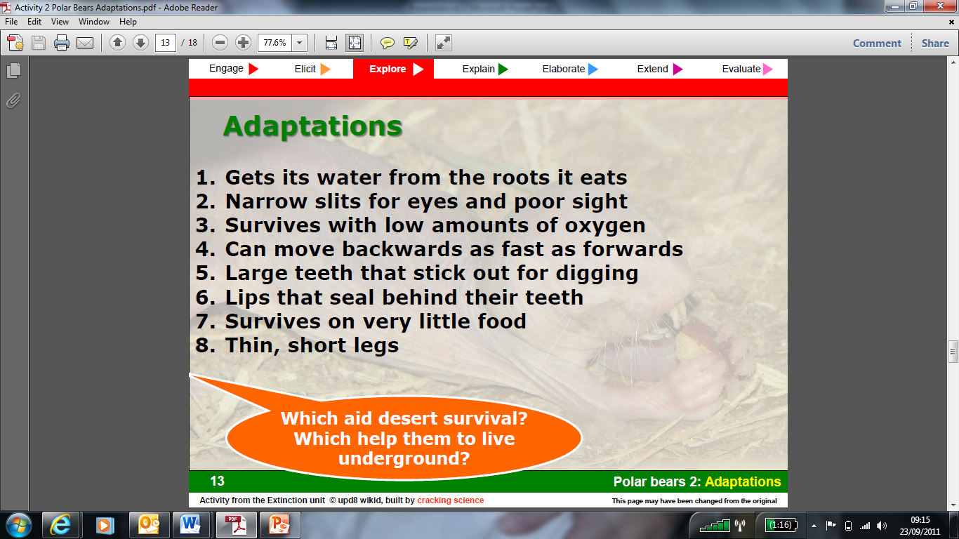

Slide 11
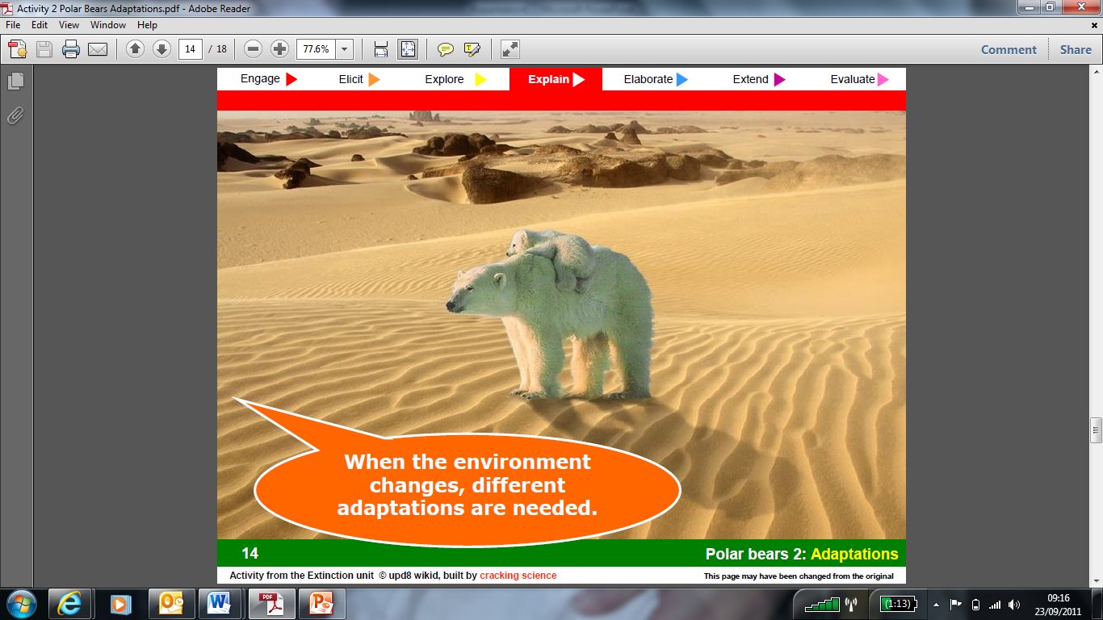

Slide 12
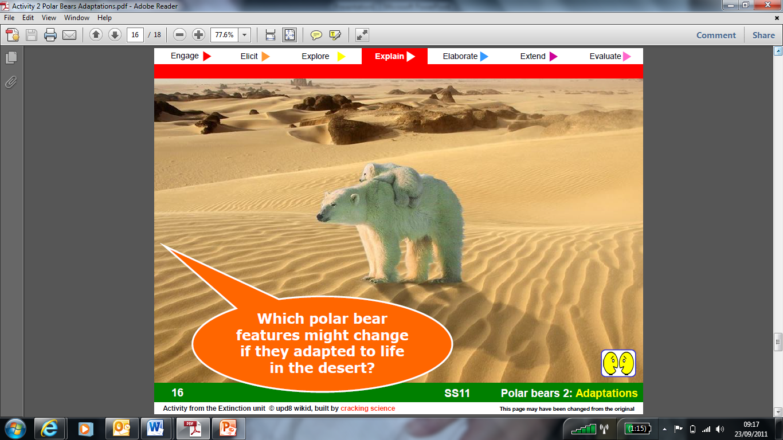

Slide 13
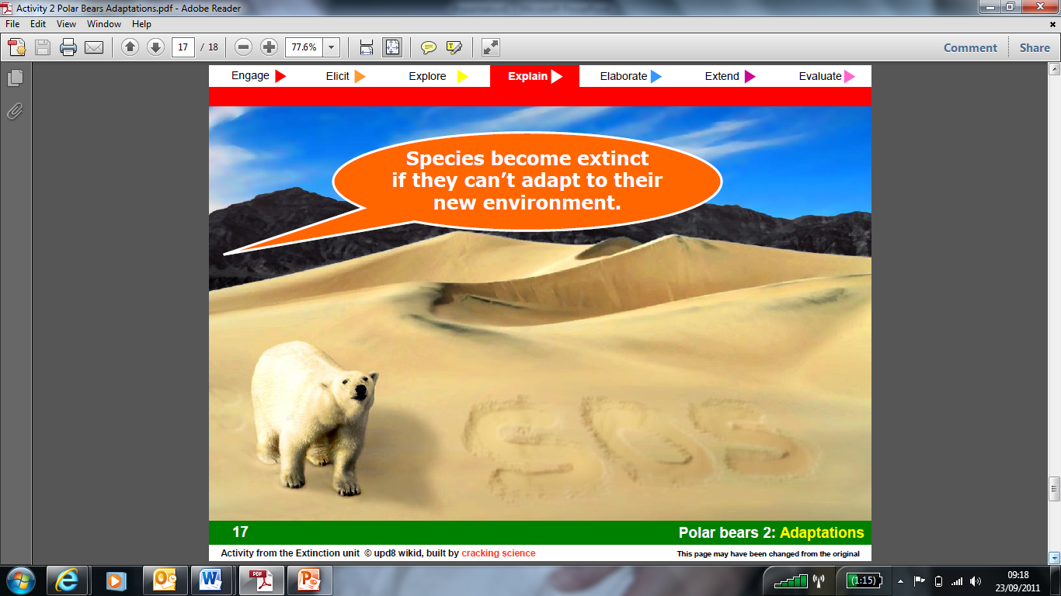

Slide 14
Your Task:
You will now be assigned an animal. To start with, answer the following questions as if you are that animal:
Do you hang round in a gang, or on your own?
What are you good at?
What do you eat?
How do you get around?
How do you avoid freezing to death?
Now, prepare a presentation to the class to describe how this animal is adapted to live in the Arctic (you may use the picture in your presentation to point out certain features)

Slide 15
A
Think of an adaptation that humans
have for each letter of the key word
D
A
P
Example: T= Teeth to chew/tear our food
T
A
T
I
O
N

